Slide 1
EEG Based Affective Design
Literature research 1024 report
Notes:
还是想一下有意义的结论是什么？
在哪里发论文？
已发的论文是怎么样的？
对我们的论文参考？

Slide 2

Search Overview
Related Keywords:
“Affective, affect, emotion, mood
“Monitor, iteration, feedback, regulation
“interaction design, BCI
“EEG, ERP
“Colors, light, visual
Searching Keywords:
“affect/ affective/ mood, interaction design, EEG
“emotion, interaction design, ERP
“interaction design, EEG based
“brain computer interface, visual

Slide 3
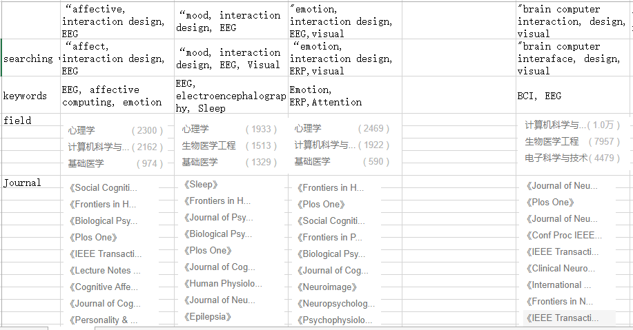
Search Overview
Notes:
关注研究：如何表征情绪、情感，如何解读不同的信号 （基础事实）
关注算法：如何更准实现情绪、情感识别 - affective computing
关注应用：义肢、康复、游戏体验（心流）、冥想（正念）- brain computer interface

Slide 4
Interaction
Passive brain activity – mental state – patterns recognition
Active brain activity – motor imagery – ERP(P300/ N400), VEP

Slide 5
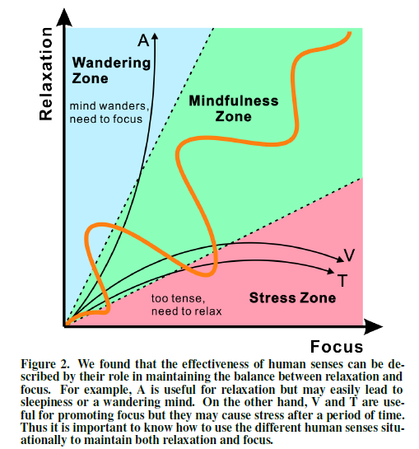
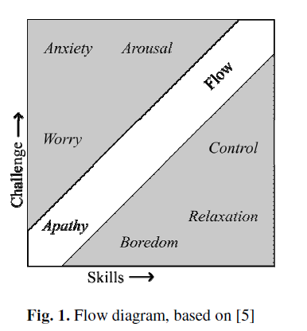
Mental state
Notes:
Csikszentmihalyi, M.: Flow: the psychology of optimal experience. Harper & Row, New York (1990)
Ahmed, M. M. H., Silpasuwanchai, C., Niksirat, K. S., & Ren, X. (2017). Understanding the Role of Human Senses in Interactive Meditation. CHI Conference on Human Factors in Computing Systems (pp.4960-4965). ACM.

Slide 6
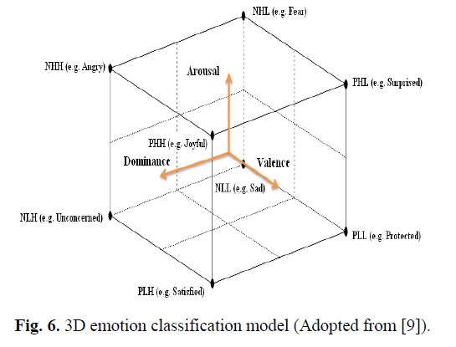
Affective model
Notes:
How to feedback and change emotion or moods?

Slide 7
“EEG based interaction design
Sourina, O., & Liu, Y. (2015). EEG-Based Serious Games. Subconscious Learning via Games and Social Media. Springer Singapore.
Sourina, O., Liu, Y., Hou, X., Wei, L. L., Muellerwittig, W., & Wang, L., et al. (2016). Neuroscience Based Design: Fundamentals and Applications. International Conference on Cyberworlds (pp.250-257). IEEE.
Sourina, O., & Liu, Y. (2014). EEG-enabled Affective Human-Computer Interfaces. Universal Access in Human-Computer Interaction. Design and Development Methods for Universal Access. Springer International Publishing.

Slide 8
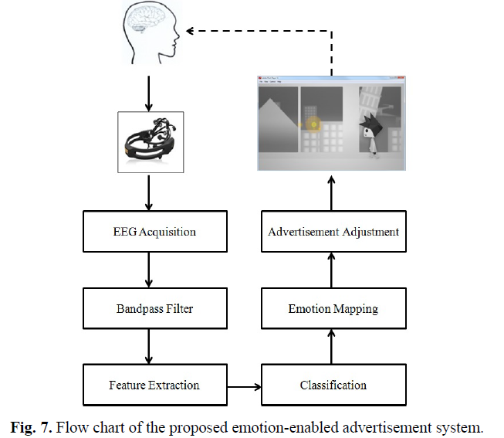
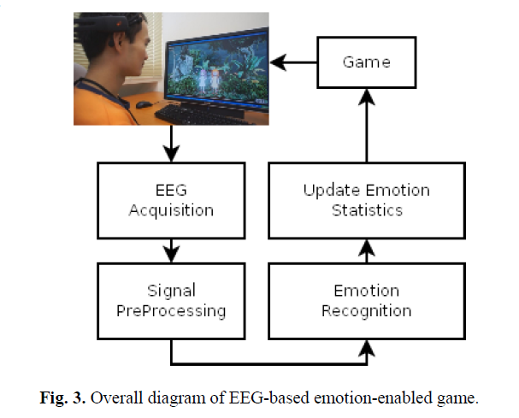
Affective games
“Bar” game – level change;
“Girl Twins” game – emotional companion, improve engagement;
adaptive advertisement

Slide 9
Game
Nijholt, A., Reuderink, B., & Bos, D. O. (2009). Turning Shortcomings into Challenges: Brain-Computer Interfaces for Games. International Conference on Intelligent Technologies for Interactive Entertainment(Vol.9, pp.153-168). Springer Berlin Heidelberg.
Gurkok, H., Nijholt, A., & Poel, M. (2017). Brain-Computer Interface Games: Towards a Framework. Springer Singapore.
Mason, S. G., & Birch, G. E. (2003). A general framework for brain-computer interface design. IEEE Transactions on Neural Systems & Rehabilitation Engineering A Publication of the IEEE Engineering in Medicine & Biology Society, 11(1), 70.
Notes:
Tasking - Flow
Meditation - mindfulness

Slide 10
Mind Balance game
Lalor, E., Kelly, S.P., Finucane, C., Burke, R., Reilly, R.B., McDarby, G.: Brain Computer Interface based on the Steady-State VEP for Immersive Gaming Control. In: Graz BCI Workshop (2004)
Hjelm, S.I., Browall, C.: Brainball – Using brain activity for cool competition. In: Proceedings of NordiCHI (2000)
Lin, T.A., John, L.R.: Quantifying Mental Relaxation with EEG for use in Computer Games. In: International Conference on Internet Computing, pp. 409–415 (2006)

Slide 11
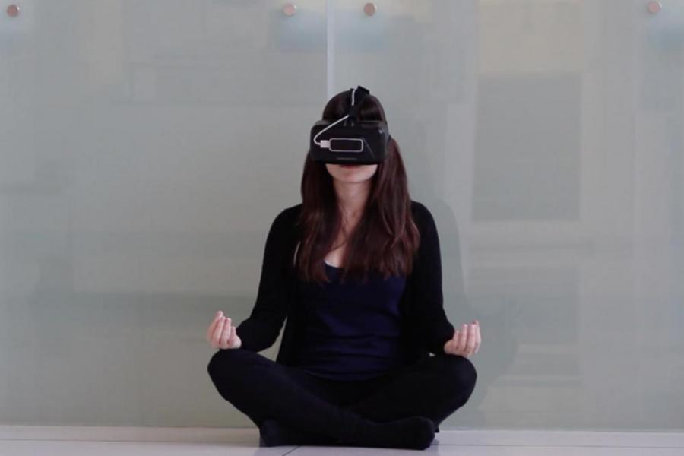
PsychicVR
Amores, J., Benavides, X., & Maes, P. (2016). Psychicvr: increasing mindfulness by using virtual reality and brain computer interfaces. 2-2.

Slide 12
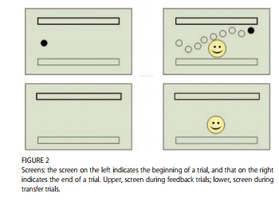
Neurofeedback Game for ADHD
Gündoğmuş, E. (2006). Self-regulation of slow cortical potentials: a new treatment for children with attention-deficit/hyperactivity disorder. Pediatrics, 118(5), 1530-40.

Slide 13
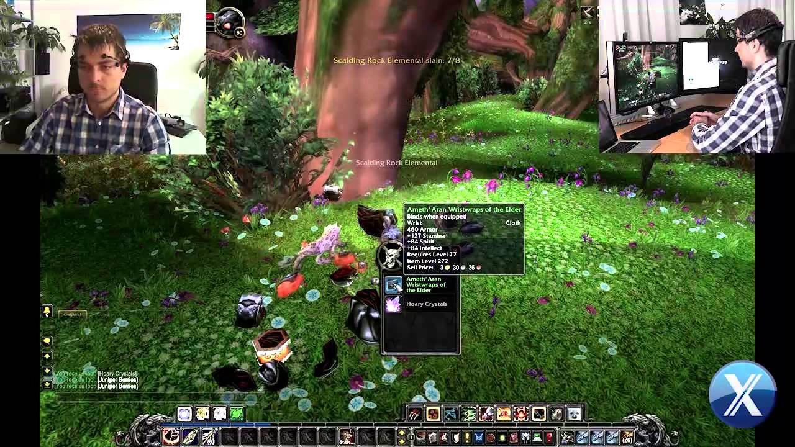
Motor Imagery
The Berlin Brain-Computer Interface [14] has used motor imagery to play Pacman and Pong and similarly familiar games such as Tetris. Motor imagery applications exist for a First-Person Shooter game [30], navigating a ball in an environment where the ball has to jump over hills [24], navigating in Second Life [13] or other virtual environments, or controlling Google Earth [34].

Slide 14
How to incorporate EEG with interaction design?
Interaction effect measure
(evaluate affect impact through physiological measures?
(find indicators of state of mind with better ecological validity in design context?
In-time adaptive design
(reveal feedback approaches – case study
Notes:
我想怎么做？
自上而下的“感知”研究 - 高度个人化 ：语境（引导，联想）与 “物理差异”对内心状态影响 －“白色谎言”（设计的关注点）- 有些认知容易改变，有些认知不容易受外界影响
设计导向 –功能，意义与生态效度（康复、冥想、心流） – EEG作为状态引导或检验评估方法（如PASUSE基于case study的规律总结）
（我主要是想学着怎么用和分析，并且思考如何用于设计过程，也可以考虑做设计现象的研究而后数据可视化，比如帮助人理解空间体验？）

Slide 15
“color, emotion, EEG
Palmer, S. E., & Schloss, K. B. (2010). An ecological valence theory of human color preference. Proceedings of the National Academy of Sciences of the United States of America, 107(19), 8877-82.
“Color preference arises from people’s average affective responses to color-associated objects”
“People like colors strongly associated with objects they like”

Slide 16
Related companies
IBM Microsoft
Sony Nintendo
Emotiv NeuroSky OCZ

Slide 17
Drive simulation
Tiwari, R. K., & Giripunje, S. D. (2014). Design approach for eeg-based human computer interaction driver monitoring system. Ijltet Org, 3(4), 250-255.
Haufe, S., Treder, M. S., Gugler, M. F., Sagebaum, M., Curio, G., & Blankertz, B. (2011). Eeg potentials predict upcoming emergency brakings during simulated driving. Journal of Neural Engineering, 8(5), 056001.

Slide 18
“virtual environment, mood, EEG
Rodríguez, A., Rey, B., & Alcañiz, M. (2013). Evaluating virtual reality mood induction procedures with portable eeg devices. Studies in Health Technology & Informatics, 191, 131.
(graphic and environment ?)

Slide 19
Leslie, G., Picard, R., & Lui, S. (2015). An EEG and Motion Capture Based Expressive Music Interface for Affective Neurofeedback. The, International Workshop on Brain-Computer Interfacing.

Slide 20
Other physiological approaches than EEG
Respriation

